Slide 1
Research Workshop
Edurne Scott Loinaz, BA, MA (Ed)

Slide 2
Goals for today:
Highlight the outcome and feedback measures already in place in your NG
Identify the mechanisms that help create positive outcomes
Create your program theory

Slide 3
What works, for whom, in what circumstances, how and why?
If [Context] … Because [Mechanisms] …. Then [Outcome]
Notes:
Central to answering this question is the reconstruction of the policy (or program) theory. The policy theory is the sum of assumptions or hypotheses that explain how the intervention should work.

Slide 4
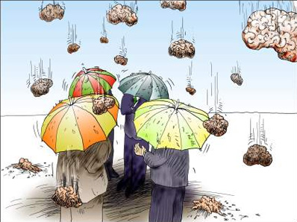
What makes a NG a NG?
Notes:
Split into groups of 3-4- write down all the characteristics of what makes the following: a nurture room, a nurture child, a nurture teacher, a nurture school, nurture provision.

Slide 5
The nurture room
Always two staff/adults in the room
Small group size 8-12
Furnished to be reflective of both home and school
Contained and protected
Big enough for large range of domestic and personal activities including ‘breakfast’ and experiences at baby and toddler level
Dedicated room in school, with homely feel and different zones, and space for children’s personal things
Atmosphere of room is welcoming and homely
Location means the room is not isolated or constantly disrupted

Slide 6
The nurture child
Triangulated referral (e.g. assessment tools, consultation with staff, parents)
NG staff’s views integral to group selection
Responsive to individual need e.g. child who’s experienced bereavement
Group balance/ group dynamics considered e.g. gender balance
Children who are disengaged
Children who have not developed certain social, emotional and behavioural skills are selected e.g. “fill missing gaps”
Children whose parents care, but parents need help and support to develop their skills
Children who are ‘neglected’
Children with attachment difficulties

Slide 7
The nurture teacher
Challenge and Support: “Tough caring”. Challenge others in pupil’s best interests e.g. don’t take on unnecessary curriculum demands
Confidence: Emotional resilience/ keeping calm
Creating Trust: Being consistent and fair
Respect for Others: underlying belief individuals matter/deserve respect
Analytical Thinking: ability to think logically
Conceptual Thinking: see patterns and links
Drive for Improvement: set and meet challenging targets
Information Seeking: drive to find out more and get to the heart of things; intellectual curiosity
Initiative: anticipate and pre-empt events
Flexibility: adapt to needs of a situation, change tactics
Hold People Accountable: set clear expectations
Managing Pupils: provide clear direction to pupils, and enthuse them
Passion for Learning: drive and an ability to support pupils in their learning
Understanding Others: i.e. why they behave as they do
Impact and influence: ability and drive to produce positive outcomes
Team-working

Slide 8
Nurture School
Whole staff awareness and understanding of the rationale and practice of the NG with all staff (e.g. including lunch supervisors) briefed about principles of group and type of provision it offers
Whole school forum to discuss intervention strategies
Head teacher/SMT have been trained in rationale/practice of NGs so have good awareness and understanding
Other staff and children have access to the group e.g. invited for snack or activity time
NG staff have high informal status in school.
NG staff feel part of the whole school team, are kept ‘in the loop’.
NG not an ‘add on’, but integral part of school, viewed positively by other children and staff

Slide 9
Nurture provision
Part time attendance in NG e.g. am only
Full time attendance in NG e.g. all day
Length of time in NG, 2-4 terms
Time set aside for meeting parents
Time set aside for paperwork and reflection e.g. an afternoon to set targets, reflect on the week and plan together For full list see: "Evidence based practice in nurture groups: using a realistic evaluation framework to explore factors affecting practice and suggest future training directions." by Oonagh M Davies (freely available online)

Slide 10
If… [Context]
Because …. [Mechanisms]

Slide 11
Nurture group components
Affective bonds
Goal setting
Modelling
Cognitive restructuring/ Coping skills
Rewards
Role-play exercises
Affective education
Structured tasks
Homework
Relaxation Techniques
Parental involvement
Limit setting
Notes:
Choose three of the components and write a specific example of how it was used and to what outcome. Take your time to reflect.
“A mechanism is thus a theory.”
Building affective bonds
Builds positive, trusting relationships with pupils/good rapport/familiarity (Affection, attention, caring physical contact, early basic experiences and the reassurance that the student is valued)
Labelled praise
Emotionally nurturing atmosphere
Responsive to individual needs
Consensual goal setting
Sets achievable targets from Boxall Profile assessment
Reviewing/reinforcing target behaviour/skills
Modelling
Role modelling of appropriate behaviour/social skills between two adults participating in constructive interaction
Peer modelling
Coping template / Positive self-instruction / Cognitive restructuring
Methods to generate alternative solutions/evaluate options
Perspective taking
Recognising triggers of anger
Forecasting future setbacks
Deliberate exposure to what triggers negative thoughts/reactions along with a coping template
Distinguishing between helpful and unhelpful thoughts
Graded hierarchy approach (breaking-down worrying situations into manageable steps)
Identifying other people who use good coping models
Rewards
Behavioural reward systems: marble jars, team targets, sticker charts
Prizes/gifts/books (dependant on behaviour and achievable targets)
Golden time
Extra play time
Time with favourite teacher/class pet
Taking the class toy home
Role-play exercises / Social skills training
Practicing/rehearsing skills
Re-enacting hypothetical situations
Affective Education
Understanding, identifying and labelling emotions
Recognising physical and environmental cues of emotions
Providing opportunities for pupils to verbalise their emotional experiences
In-session curriculum / Structured tasks
Curriculum planning and assessment as a collaborative responsibility between the nurture group practitioner and the mainstream teacher
Circle time
Homework
Assigning and reviewing tasks to complete
Setting up behaviour charts for implementation at home/practicing skills
Relaxation techniques
Mindfulness
Controlled breathing techniques
Identifying a range of activities which students find enjoyable and relaxing
Parental involvement
Staff provide ideas/equipment for home activities and support parents to develop appropriate interaction strategies and management for home
Parent praise
Open afternoons or evenings are often held termly and younger siblings are welcomed
A few parents spend part of the day or the entire day in the nurture group
Limit setting
Ignoring negative behaviour
Traffic light system
Time ‘in’

Slide 12
If [Context]…
Because …. [Mechanisms]
Then … [Outcomes]

Slide 13
What outcome measures could be used to track progress in NG provision?

Slide 14
Quantitative Data
Information that is based on quantities obtained using a quantifiable measurement process
The Individual Pupil
Gains in social and emotional functioning – BP, SDQ, BIOS
Academic achievement
Attendance
The School
Impact on fixed period and permanent exclusions
Staff turnover
Costs on support programmes for students with SEBD
Number of referrals to external authorities
Notes:
Behavioural Indicators of Self-Esteem Scale

Slide 15
Qualitative Data
Information that is descriptive, subjective or difficult to measure.
Feelings in different contexts:
During lessons/Lunch/Moving between buildings/Class trips
Specific statements:
I like school
I have friends at school
I have someone to play with at lunch
I feel safe at school
My teacher likes me
I like my teacher
Notes:
Parents
Changes in interaction with children at home
More involvement and engagement with school community

Slide 16
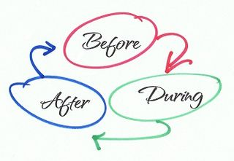
Before NG provision (ex ante) During (ex durante) After (ex post)
 | Pre | Date | During | Date | Post | Date
Boxall Profile - Developmental
Boxall Profile - Diagnostic
Attendance
Numeracy
Literacy
Notes:
The more data you get the better.

Slide 17
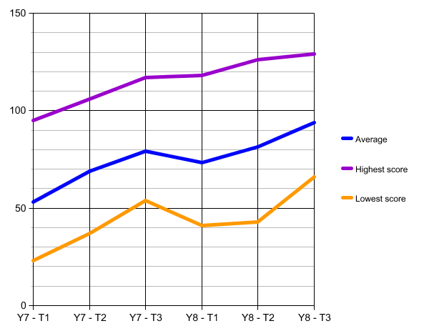
Change in Developmental Boxall Scores in six academic terms.
Low-risk
Borderline
High risk
Notes:
The longer you track the data the better

Slide 18
Outcome and feedback measures
Use existing literature NGs have an impressive evidence-base, including high-quality, non-randomised controlled studies – use them! Your NG is not an island!
Notes:
.

Slide 19
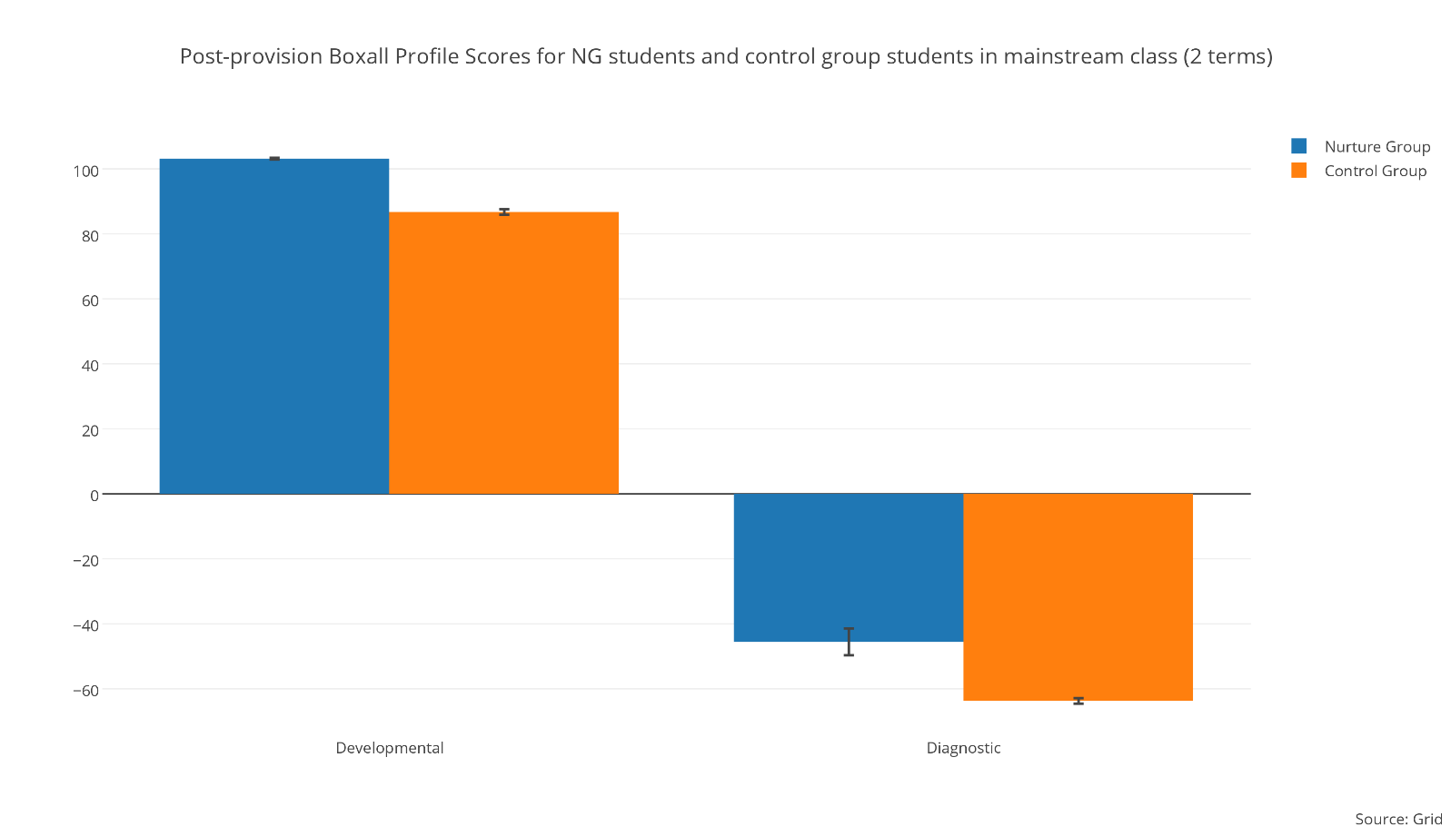
 | SDQ score | Developmental Strands | Diagnostic Profile
Normal | 0-11 | 93.64 – 136 | 0 – 38.72
Borderline | 12-15 | 72.44 – 93.63 | 38.73 – 56.64
Abnormal | 16-40 | 0 – 72.43 | 56.65 – 136
N= 350 students (186 NG, 164 CG)
Low-risk
Borderline
High-risk
NG students
Control group
NG students
Control group
Low-risk
Borderline
High-risk
Developmental scores
Diagnostic scores
Notes:
You will be asked – how can you know for certain that these outcomes are due to NG provision? You reply: non-randomised controlled studies have proven that children attending nurture group provision compared to those that remained in their mainstream class for more than two terms, significantly improved their social, emotional and behavioural issues and academic achievement

Slide 20
Study | Sample | Matched | Variables/ measures
Cooper, Arnold, and Boyd (2001) | N= 342, 216 NG, 64 matched with SEBD, 62 matched without SEBD.. | Matched on age (4-10-year-olds), gender, educational attainment and level of SEBD | - BP - SDQ (teacher) - Teacher rated educational progress (TREP)
Cooper and Whitebread (2007) | N=543, 359 NG, 95 matched with SEBD, 89 matched without SEBD | Matched on age (4-14-year-olds), gender, educational attainment and SEBD | - BP - SDQ (teacher)
Reynolds, MacKay, and Kearney (2009) | N=221, 117 NG, 104 matched with SEBD | Schools matched on socio-economic status, number of pupils on roll, and level of need. Children matched by BP (5-7-year-olds) | - BP - SDQ (teacher) - Baseline assessment for early literacy - BIOS
Scott and Lee (2009) | N=50, 25 NG, 25 matched with SEBD | Matched on age, gender, educational attainment (4-10-year-olds) | - BP - Literacy measures - Numeracy measures
Seth-Smith et al. (2010) | N=83, 44 NG, 39 matched with SEBD | Matched on gender and ethnicity (4-8-year-olds) | - BP - SDQ (teacher) - Formal assessments of academic attainment
Notes:
Non-randomised studies

Slide 21
If [Context]…
Because …. [Mechanisms]
Then … [Outcomes]
But [Limitations]
Notes:
There will always be limitations to any provision – we know that, for example, if improvements aren’t visible after two months it is a good idea to access outside help. There are also limitations for improvement in nurture groups with children with autism or children with moderate learning difficulties. No provision is a silver bullet – understanding the limitations of a provision is crucial to creating a program theory.

Slide 22
My nurture group program theory:
If [Context] (child, teacher, school, nurture group, frequency) … Because [Mechanisms] (affective bonds, modelling, coping skills, parental involvement, goal setting etc.) … Then [Outcome] (improved behaviour, academic achievement, attendance)

Slide 23
Goals for today:
Highlight the outcome and feedback measures already in place in your NG
Identify the mechanisms that help create positive outcomes
Create your program theory

